Slide 1

D3.js
CMPT 384 – Information Visualization
Lab 2
Course Instructor: Debajyoti Mondal
Lab Tutorial Instructor : Arman Heydari( arman.heydari@usask.ca )

Slide 2
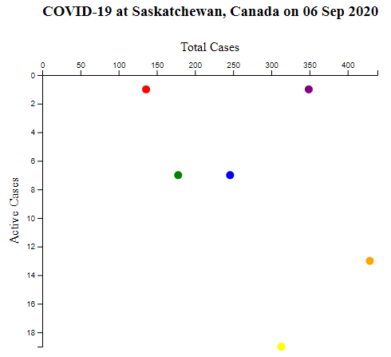
Agenda
D3 default max, min function
D3 Scales – Linear scale
D3 Axis (left and top)
D3 Transformation
D3 scatter plot draw*
cases_6Sep20.csv
Region,Total_Cases,Recovered,Deaths,Color
Far North,349,341,7,purple
North,246,233,6,blue
Central (excluding Saskatoon),178,169,2,green
Saskatoon,313,292,2,yellow
South (excluding Regina),429,410,6,orange
Regina,136,134,1,red
*no legend and no tooltip

Slide 3
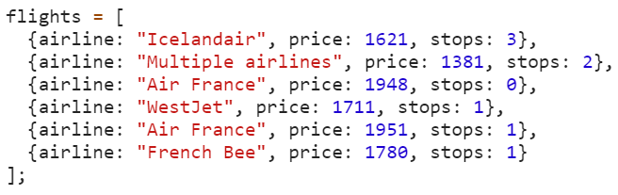
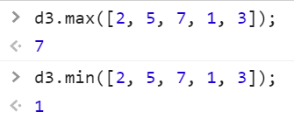
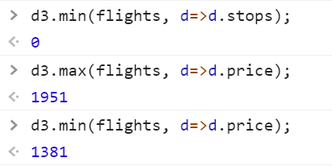
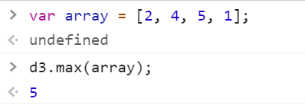
D3 Min and Max
These are default functions of D3 library
For an array of object
For an array of Int

Slide 4
D3 Scales
Continuous Scale
Linear, Power, Log, Time
Sequential Scale
Diverging Scale
Quantize Scale
Quantile Scale
Ordinal Scale

Slide 5
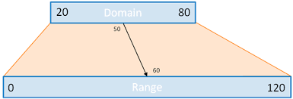
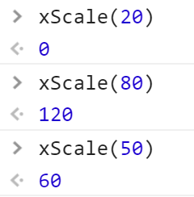
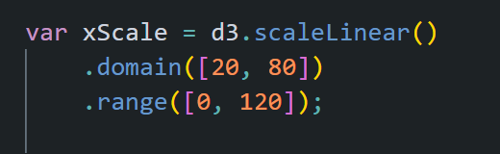
D3 Scales – Linear Scale
http://www.jeromecukier.net
Domain – what we have, e.g. data range
Range – what we want, e.g. pixel range for chart

Slide 6



D3 Axis
Top Axis : d3.axisTop(<need to pass a scale>)
Bottom Axis : d3.axisBottom(<need to pass a scale>)
Left Axis : d3.axisLeft(<need to pass a scale>)
Right Axis : d3.axisRight(<need to pass a scale>)
Left
Right

Slide 7
D3 - Transformation
<text>hello</text>
hello
X-axis
X-axis
Translation:
hello
<text transform="translate(10, 10)"></text>
Rotation:
Y-axis
Y-axis
<text transform=“rotate(-45)"></text>
before any transformation
translate(10, 10)
<text transform=“rotate(45)"></text>
X-axis
Translation and Rotation:
hello
<text transform=“translate(10, 10) rotate(45)"></text>
hello
X-axis
Scale, Skew
X-axis
Y-axis
hello
Y-axis
rotate(45) - clockwise
rotate(-45) – anti-clockwise
Y-axis
translate(10, 10) rotate(45)

Slide 8
D3 Circle draw
Radius, r
<circle r="5" cx=“10" cy=“8“></circle>
Fill : define the color to fill the circle
Stroke : define the color of the border
Stroke-width : define the width of the border
Center (cx, cy)

Slide 9
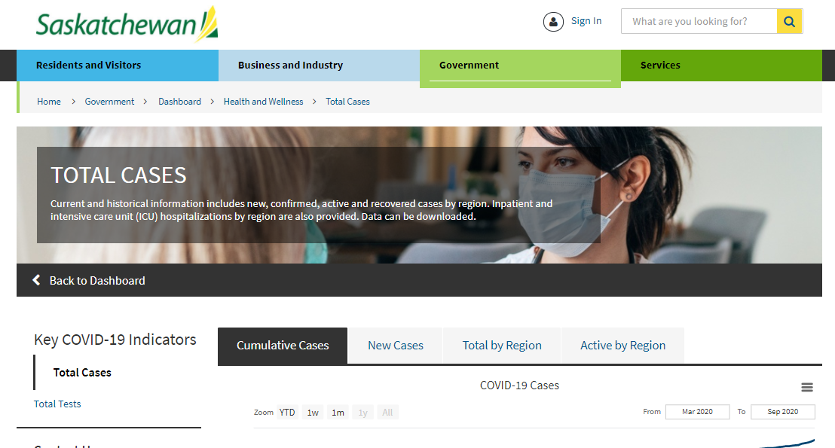
Data Source
COVID-19 Cases at Saskatchewan, Canada on 06 September 2020
cases_6Sep20.csv
Region,Total_Cases,Recovered,Deaths,Color
Far North,349,341,7,purple
North,246,233,6,blue
Central (excluding Saskatoon),178,169,2,green
Saskatoon,313,292,2,yellow
South (excluding Regina),429,410,6,orange
Regina,136,134,1,red
https://dashboard.saskatchewan.ca/health-wellness/covid-19/cases

Slide 10
Start the server
Go to your folder and run the server
First command is for python version < 3.0 and the second one if python version >= 3.0.
Microsoft Windows [Version 10.0.15063]
(c) 2017 Microsoft Corporation. All rights reserved.
C:\> python -m SimpleHTTPServer 8888
C:\Users\jyoti\AppData\Local\Programs\Python\Python37-32\python.exe: No module named SimpleHTTPServer
C:\> python -m http.server 8888
Serving HTTP on 0.0.0.0 port 8888 (http://0.0.0.0:8888/) ...

Slide 11
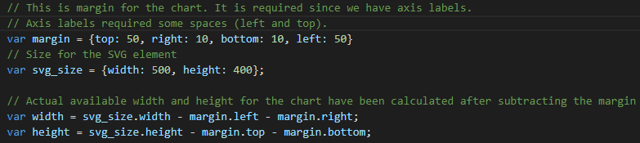
Scatter plot - margin
svg_size.width
<svg>
margin.top
margin.left
svg_size.height
width
height
<g>

Slide 12
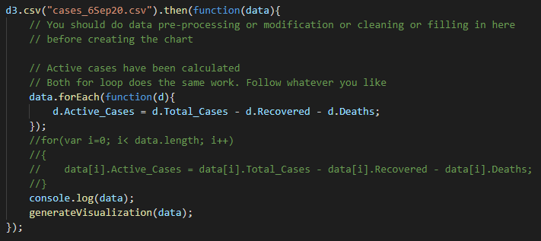
Scatter plot – Read CSV
Good practice to do all data pre-processing, modification, cleaning or filling before creating the chart
Active Cases = Total Cases – Recovered Cases - Deaths

Slide 13
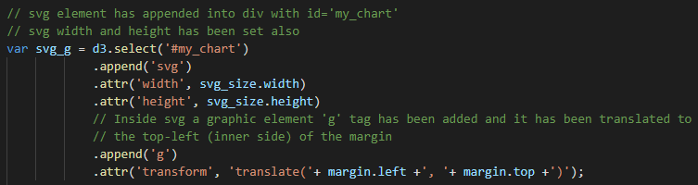
Scatter plot – svg_g variable
Origin point for <svg>
svg_size.width
append <svg> tag and set width and height
append <g> tag and translate the origin into blue dot
<g> is stored in svg_g variable. Whatever tag we add inside this <g>, it will count the origin as this blue dot (not the red dot)
<svg>
margin.top
Origin point for <g>
margin.left
svg_size.height
width
height
<g>

Slide 14

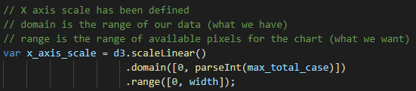

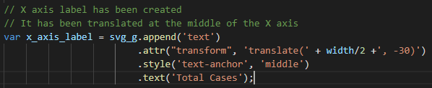

Scatter plot – X axis
Calculate the maximum Total Cases and Active cases
Text-anchor Style
X axis scale is defined
text-anchor = middle
Total Cases
text-anchor = start
Position (x, y) co-ordinate of the text element
X axis has been created
Total Cases
X axis label has been placed
text-anchor = end
Total Cases
Looks like this :

Slide 15
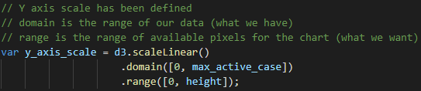

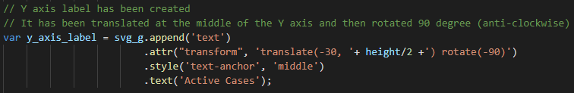
Scatter plot – Y axis
Y axis scale is defined
Looks like this :
Y axis label has been placed
Translate the label into the middle of y axis by translate(-30, height/2) and rotate it 90 degree anti-clockwise by rotate(-90)

Slide 16
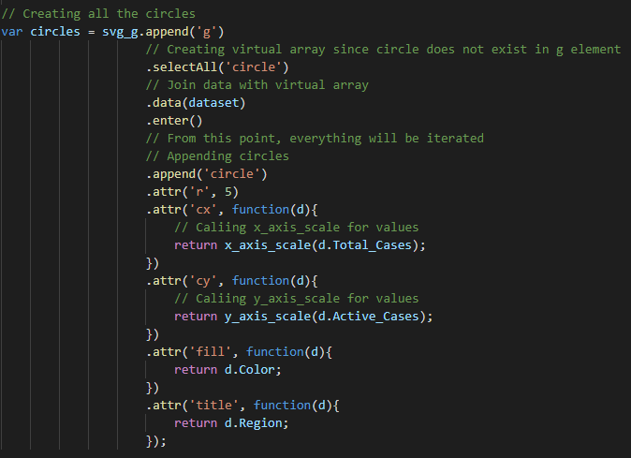
Scatter plot – drawing circles
x_axis_scale and y_axis_scale have been used to get the actual cx and cy (pixel) values for the chart

Slide 17
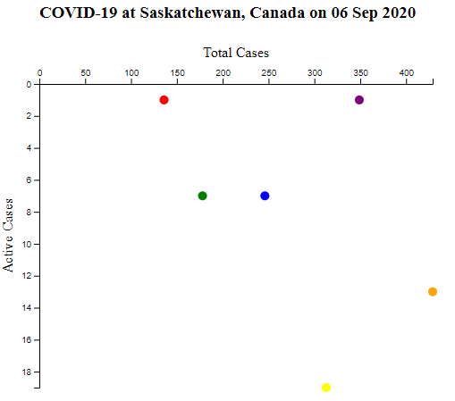
Scatter plot - finish
Those who love challenges – try to draw scatter plot with bottom(x-axis) and right (y-axis)
N.B. – To do that you might need to translate the axis at bottom or to the right

